Slide 1
Using F# with an Existing Codebase
Wesley Wiser

Slide 2
The Codebase
Actively developed for 10+ years
100,000s lines of C#
10,000s lines of Js
~10,000 lines of F#
A large amount of Web-Forms style ASPX

Slide 3
Why Add F#?
Strengths of the language
Pattern Matching
Data transformation & processing
Developer productivity
Easier to write bug-free code

Slide 4
How we use F#
Data transformation
Define data types

Slide 5
Data transformation
Map-Reduce
Not just for big data
Translation
Text markup -> Html or plain text
Xml -> Business objects
Events -> Configuration

Slide 6
Classes
“F# is a better object oriented language than C# in some ways” - Erik Meijer

Slide 7
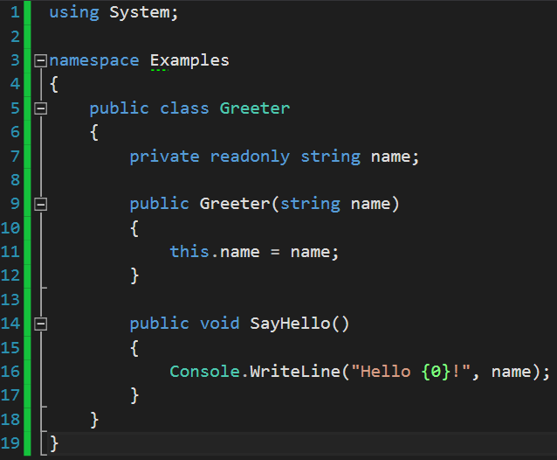
Classes

Slide 8
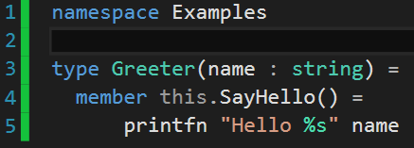
Classes

Slide 9
Object Expressions
Similar to Java’s Anonymous Class feature
Useful when you need to return an object’s interface but wish to hide the implementation

Slide 10
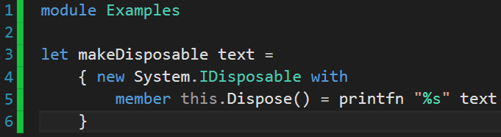
Object Expressions

Slide 11
Data Objects
F# syntax is lighter weight
F# compiler provides high-quality Equals(), GetHashCode(), and ToString() implementations for you

Slide 12
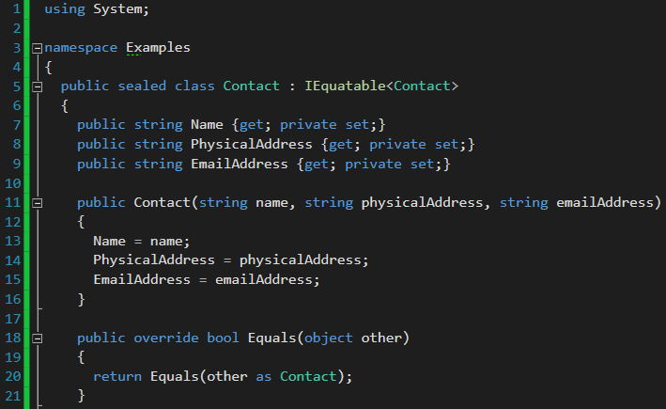
Data Objects

Slide 13
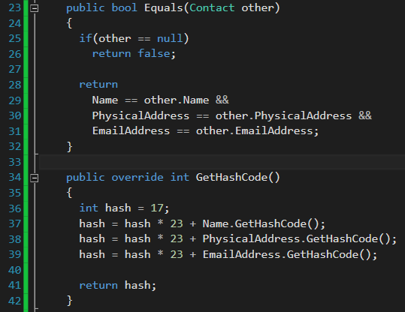
Data Objects

Slide 14
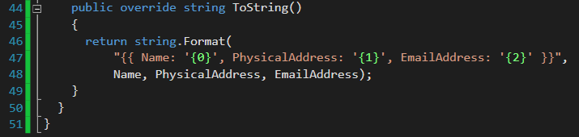
Data Objects

Slide 15
Data Objects
We could have also implemented
IStructuralEquatable
IComparable<Contact>
IComparable
IStructuralComparable

Slide 16
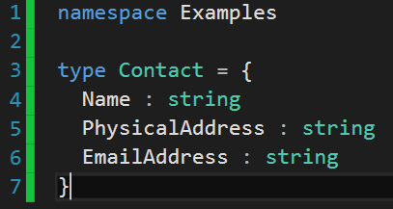
Data Objects

Slide 17
Data Objects
The F# compiler automatically implements
IEquatable<Contact>
IStructuralEquatable
IComparable<Contact>
IComparable
IStructuralComparable
and provides overrides for
Equals
GetHashCode
ToString

Slide 18
Primitive Obsession
Primitive Obsession is using primitive data types to represent domain ideas. For example, we use a String to represent a message, an Integer to represent an amount of money, or a Struct/Dictionary/Hash to represent a specific object.
http://c2.com/cgi/wiki?PrimitiveObsession

Slide 19
Primitive Obsession
What does this function do?
fun1 : string -> string -> int option

Slide 20
Primitive Obsession
What does this function do?
fun2 : Username -> Password -> UserId option

Slide 21
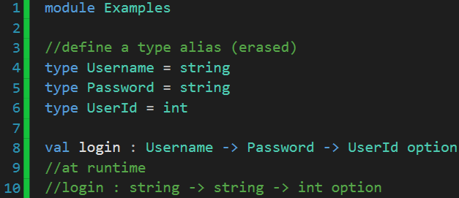
Primitive Obsession
If you were only writing F#:

Slide 22
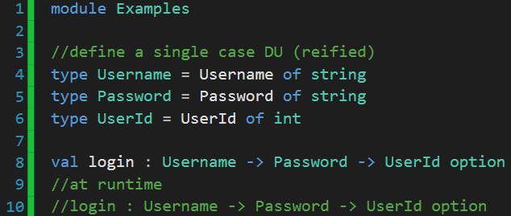
Primitive Obsession
If you need reified types:

Slide 23
Other places
Build scripts
FAKE
.fsx scripts
Infrastructure
Tests

Slide 24
That’s it
Questions or comments?
@wesleywiser

